Slide 1
Raymarching
explained by Stew Nowak

Slide 2
First, a brief overview: What is Raymarching?
For every Pixel, we MARCH a ray through the scene
Calculate the intersection of the ray with an implicit surface (SDF) i.e not coordinate based
Not a fixed step size i.e similar to ray tracing but not quite!
Special marching algorithm
We create our "geometry" via signed distance functions or SDF's
We can create many shapes that normal rasterization or explicit surfaces cannot
We achieve this utilizing a full screen quad (or triangle) and then the rasterizer
Compute or Fragment shader -> per pixel operations
AKA sphere tracing
Makes more intuitive sense once you visualize the marching algorithm

Slide 3
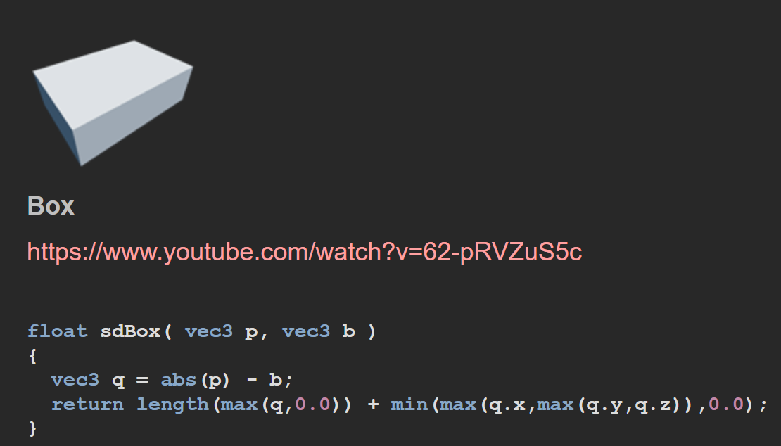
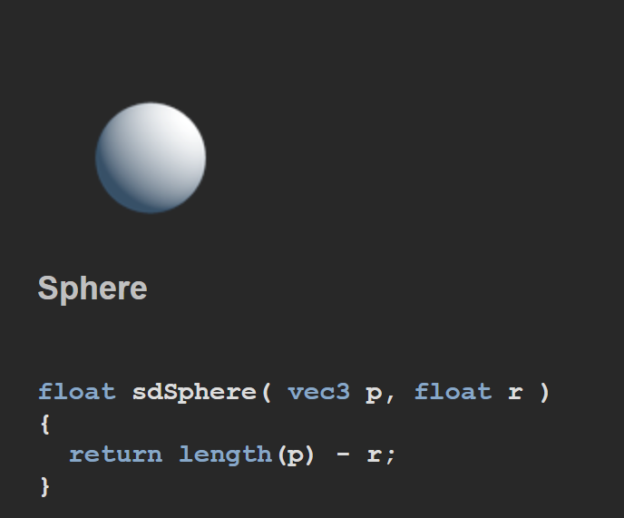
Signed Distance Functions aka SDF's
A function that represents the signed distance from a point in space to the surface of the object described
Most are exact, though some are bounded
Bounded SDF's return the underestimated distance
Slower than exact SDF's ->use an iterative function to simulate behavior then estimate distance
Ensure we don't overshoot the surface
2D, 3D, or even 4D (animation with time) shapes are possible
Mapping - >returning the distance, materials, etc. for final shading
Defines the scene/where you put all your transformations and SDF's
Credit: Inigo Quilez :: computer graphics, maths, shaders, fractals, demoscene

Slide 4
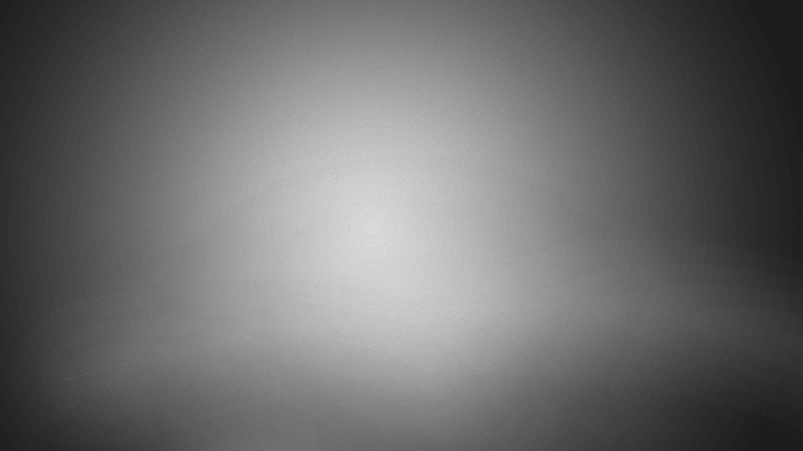
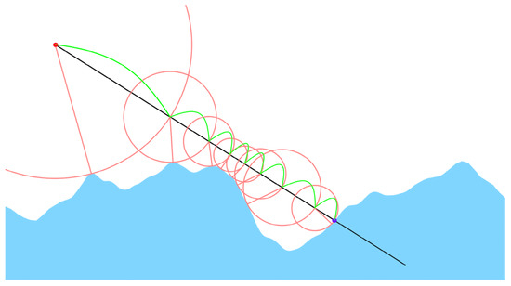
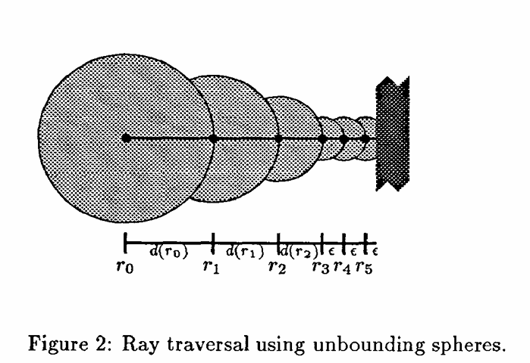
The Raymarch Algorithm
"March" the ray incrementally in steps
Each step we calculate the distance to the nearest object
We "March" until we hit a surface, exceed distance threshold, or iteration count hits our preset maximum ray step count
Don't waste computation on rays that won't intersect
Utilize Unbounding volumes i.e volumes that do not contain any part of the object
In our case the volume is a sphere, and its radius is the dist. to the object
Credit: Raymarching Distance Fields with CUDA
Credit:1910189b.tif

Slide 5
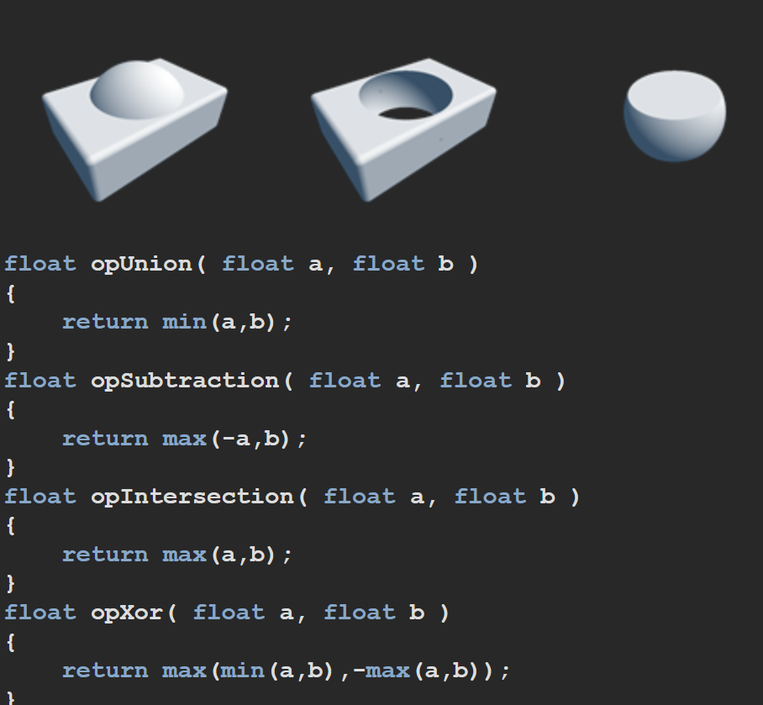
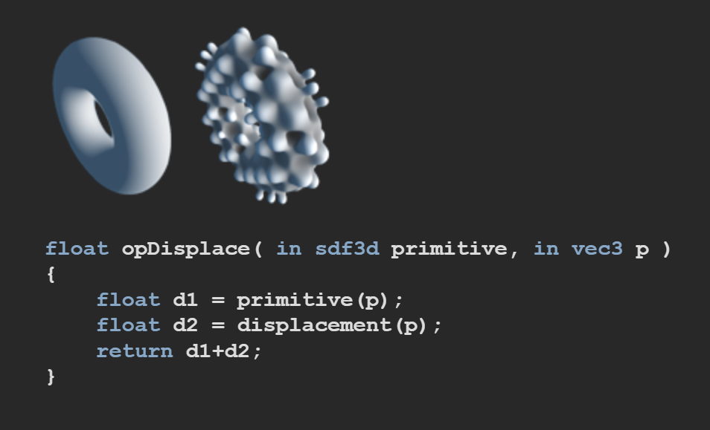
Benefits
CSG or Construct Solid Geometry is very easily done
Union, Intersect, and Difference
Distortion/Displacement, Repetition, Smoothing, and Elongation (2D->3D SDF)
Soft Shadows and Reflections are easily computed (think about the rays)
Fractals, Isosurfaces, and Volumetric Textures
Non-exact geometry CAN be done
Analytical surfaces (triangles, spheres, etc.) still easily done as well
Memory footprint is smaller than traditional rasterization
No need for VBO's & IBO's
Credit: Inigo Quilez :: computer graphics, maths, shaders, fractals, demoscene

Slide 6
Drawbacks
Very Computationally heavy
Per pixel
SDF calculation each step
Need to watch how many steps you march your ray forward or max distance
Edges of geometry "chew" up steps
Normal calculation is expensive/tricky
Generally computed using gradient...requires 6 SDF evaluations per pixel hit
Other methods: partial derivatives, or tetrahedral sampling
Can be non-exact/an approximation depending on geometry
Bound SDF's aka Distance Estimator Functions (DE's) not exact
Still work but are slower
Creating complex geometry/scenes takes time...and a LOT of math

Slide 7
Why this is perfect for my project
Fractals are implicit by nature
Defined by mathematical behavior, not geometry
No mesh can capture infinite details as fractals do
Traditional rasterization would not work (explicit triangles...no go)
Mandelbulb is defined by iteration
Points are evaluated by repeatedly applying a function:Z_{n} = Z_{n}^{k} + C = r^{k}e^{ikθ} + C for any k ∈ ℤ ≥ 2
Surface is determined by escape behavior (defined by the function)
Distance estimator enables rendering: d=½*log(r)*r/dr ->(can tweak this)
Raymarching uses the DE for efficient stepping
This is how fractal rendering was first originally explored
Luckily, lots of good resources for this project!

Slide 8
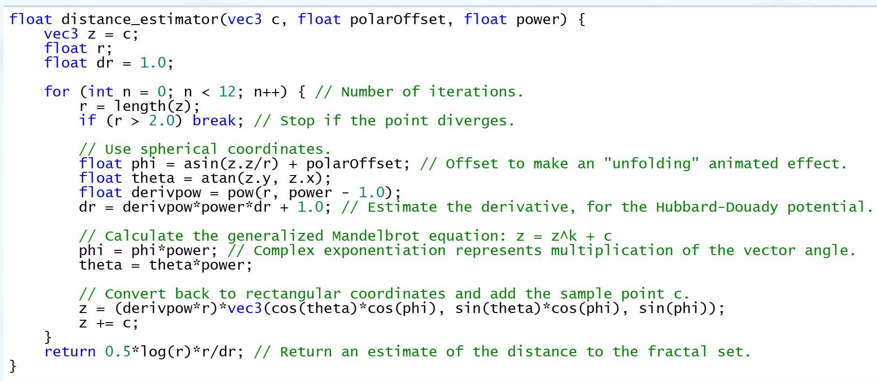
Example code:
Credit: The Mandelbulb - Ice Fractal

Slide 9
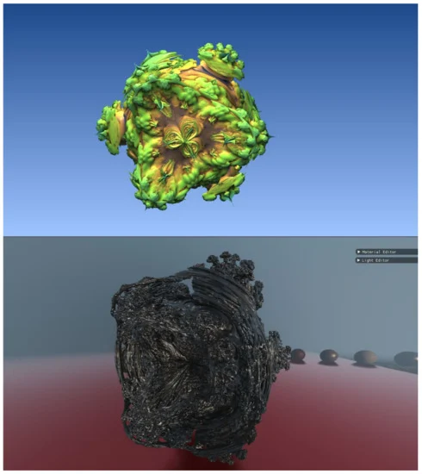
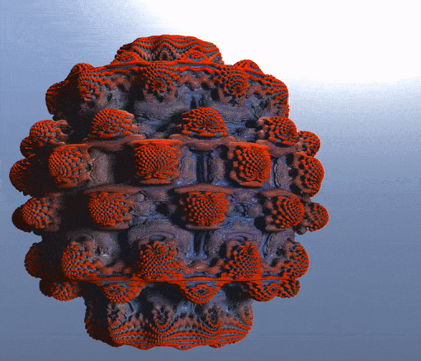
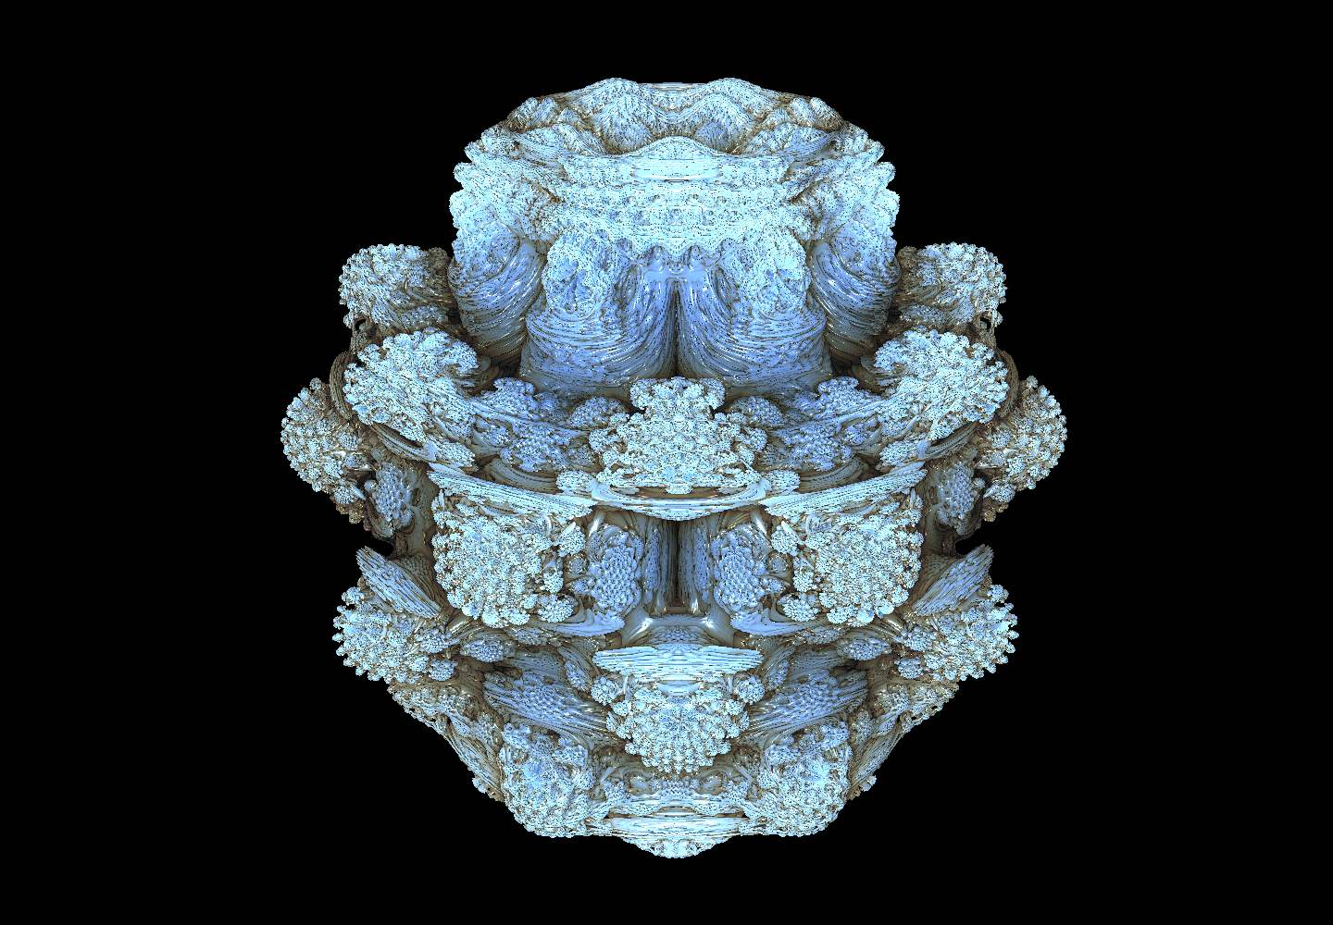
Some cool examples!
Credit: The Mandelbulb - Ice Fractal
Credit: KentaYoshii/Raymarcher: Raymarching engine built with C++ and GLSL
Credit: Raymarching Distance Fields with CUDA

Slide 10
HDR Rendering
Normally we render LDR RGB to our screen
8-bit floating point framebuffer
HDR RGB is allowing color values > 1.0 during color calculation
No bound
HDR Rendering we render to a 16-bit floating point frame buffer
Tone Mapping -> multi-pass technique
Map unclamped linear color space into clamped sRGB color space to simulate HDR imagery
Done with mathematical compression equation/curve: Reinhard, ACES, filmic, etc.
Produces more realistic lighting and contrast

Slide 11
In summary
Raymarching is a powerful technique!
Very optimizable with many parameters to tweak performance
Step count
DE iteration count
Similar to ray tracing...but also very different
VERY COMPUTATIONALLY EXPENSIVE!
Great for procedural experimentation
Increasingly becoming a noticeable technique as GPU's get stronger

Slide 12
Thank You For Tuning In!
Questions? Concerns?
Will Post some cool and intuitive videos to Ed Discussion -> Please check them out!
Inigo Quilez's presentation: Rendering Worlds With Two Triangles
Sources and Papers:
1910189b.tif
Raymarching Distance Fields with CUDA
3D Raymarching - Timm Schmidt
Inigo Quilez :: computer graphics, maths, shaders, fractals, demoscene
KentaYoshii/Raymarcher: Raymarching engine built with C++ and GLSL
The Mandelbulb - Ice Fractal ---> KILLER website/resource on fractals
Mandelbulb Viewer - Ice Fractal ---> super helpful interactive viewer on same website

